Slide 1
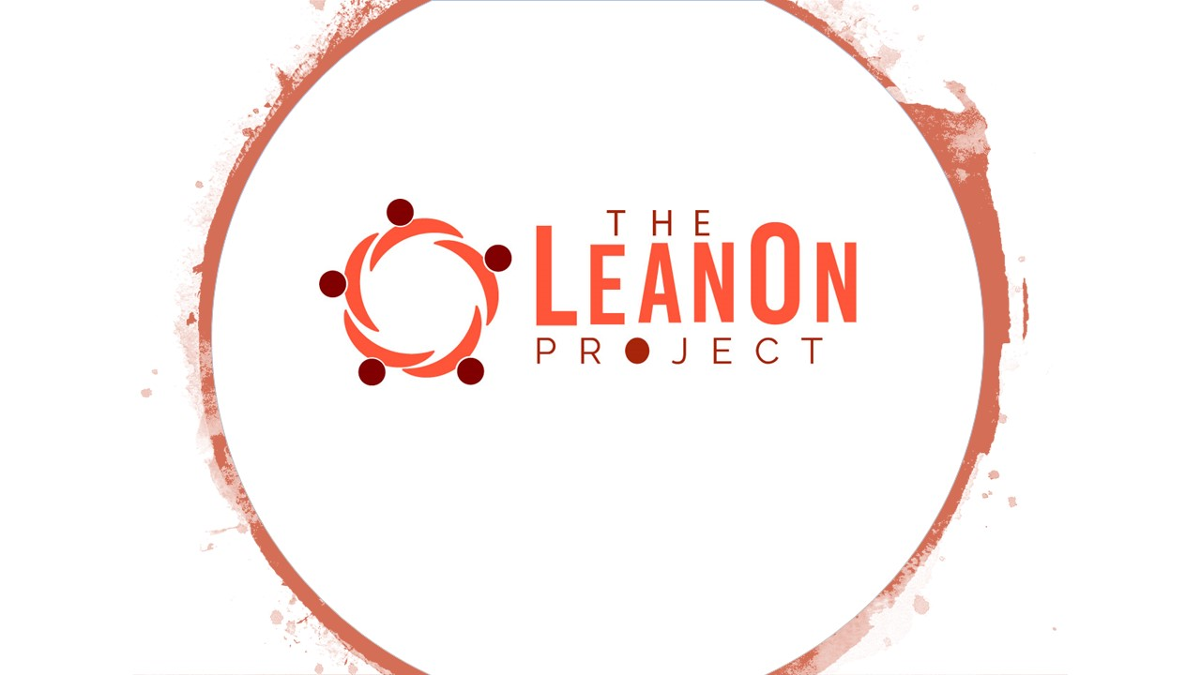
BOOTSTRAP Program

Slide 2

Introduction

Slide 3
OUR MISSION
To improve quality of life for Africa’s youth by investing in them through education, mentoring and job-centric trainings; to empower them to become economically self-sufficient and be positioned to pay it forward.

Slide 4
OUR VISION
Raising people to drive self-sufficient economies in Africa and providing them with the tools to do so.

Slide 5
The BOOTSTRAP Program
* We don’t just provide knowledge and skill.
* Our goal with this program is to create a community of Mentors and Mentees.

Slide 6





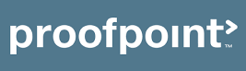
BIO
University of Ilorin, Ilorin, Nigeria
B.Eng Electrical Engineering.
Northern Kentucky University, KY
MSc Information Systems (Informatics)
University of St Thomas, MN
MSc Software Engineering.

Slide 7
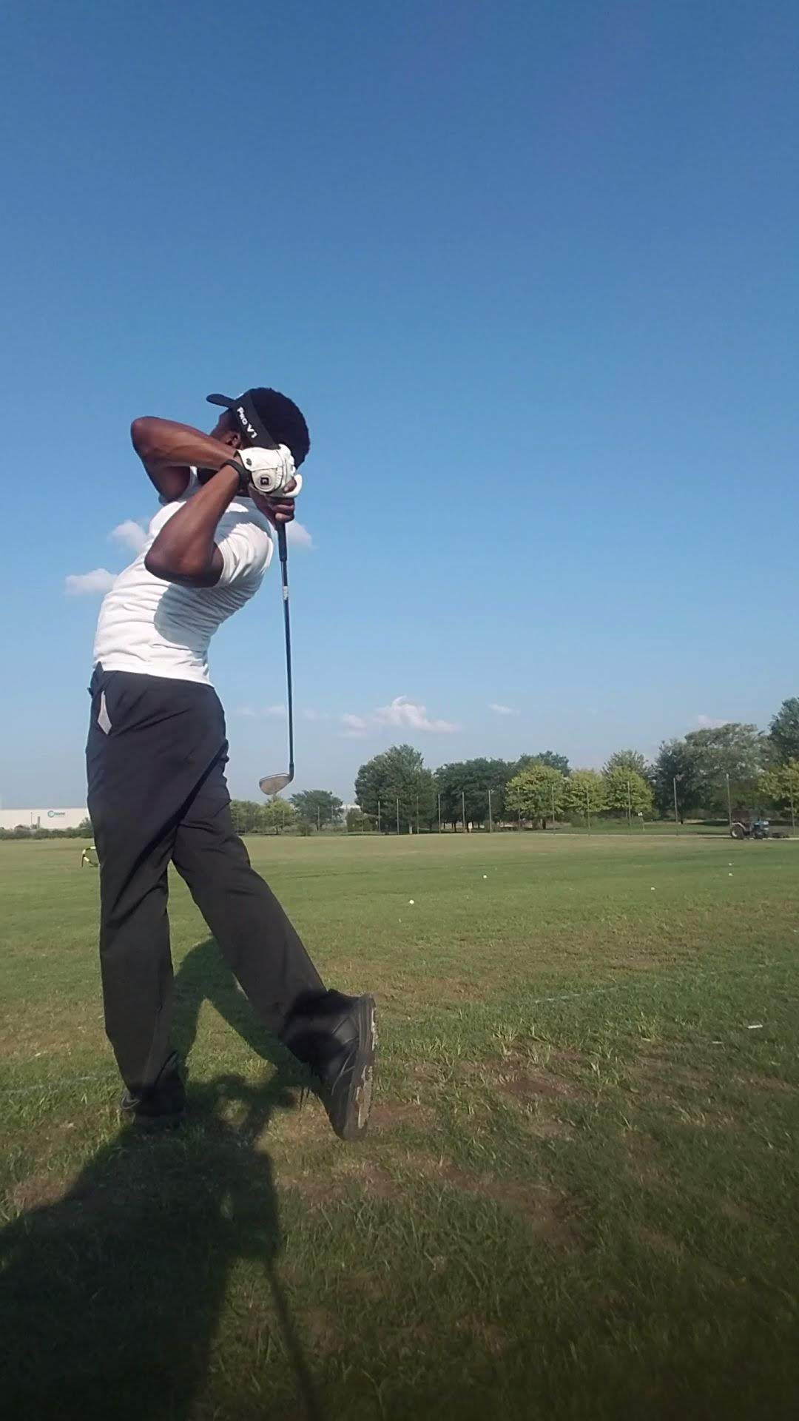
BIO
Hobbies :
Watch NBA
Play Tennis
Play Golf
Family
Married with one kid (Girl).

Slide 8
Special Thanks
Oriyomi Adepitan - NSBE President
Ayoola Adebowale - TA
And Other TAs

Slide 9
Modules
IT Infrastructure and Cloud Computing.
Software Development.
Machine Learning.

Slide 10
Software Development – S1
Introductory
“Appetizer”
General Overview Software Development Process
Project based
Source Control Using Github
Computer, Connection to internet
Teaching Assistants to help
Communication on Slack.

Slide 11
Software Development – S2
Course Outline - https://github.com/gideonaina/software-development-module
Class Structure
Lectures and Hand-on in Class..
Short Videos – Where some explained it best.
Assignment.

Slide 12
Source Control Management
Definition: “Version control, also known as source control, is the management of changes to documents, computer programs, large web sites, and other collections of information.” – Wikipedia
In our class, source control is about maintaining a history of all the changes made to code files.
We use source control systems to:
Store and track changes in software source code and application configurations (or most any sort of text-based artifact)
Maintain different releases of software code
Effectively collaborate as a team on a single set of artifacts
Slide Credit – Jason Baker (infrastructure-class)

Slide 13
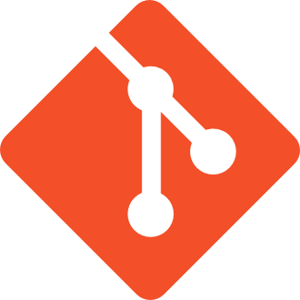
Git
Most popular open source distributed source control management system.
Initially designed by Linus Torvalds (Linux) in 2005.
Goals:
Super fast patching.
Supports one developer or thousands of developers.
Designed from a file-system perspective, not a source control management perspective.
Git vs Github
https://en.wikipedia.org/wiki/Source_lines_of_code
Slide Credit – Jason Baker (infrastructure-class)

Slide 14
Git
Terms
Commit
Pull Request
Merge
Branch
Remote Branch
Local branch

Slide 15
Hands On
Installation, Configuration and Usage
https://www.youtube.com/watch?v=SWYqp7iY_Tc
Introduction to Git Core Concept
https://www.youtube.com/watch?v=uR6G2v_WsRA

Slide 16


LINK
https://www.linkedin.com/in/gideonaina/
https://twitter.com/igideonaina

Slide 17
FUNNY
https://youtu.be/WtACYmRKQ-U?t=621

